Slide 1
Introduction to Space Biology Data
Notes:
Welcome to the lesson “Introduction to Space Biology Data”.
Meeting in _TOPS training_-20240312_151941-Meeting Recording.mp4

Slide 2
Objectives
Identify model organisms used for space biology research
Describe experiments for space biology research
Define data types and formats for space biology experiments
Define data types and formats for machine learning models
Identify significantly different arithmetic means
Notes:
The objectives of this lesson are:
Identify model organisms used for space biology research
Describe experiments for space biology research
Define data types and formats for space biology experiments
Define data types and formats for machine learning models
Identify significantly different data distributions

Slide 3
Identify model organisms used for space biology research
Notes:
In this first section, we will identify model organisms which are used for space biology research.

Slide 4
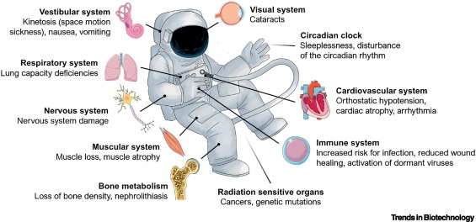
There are several factors that impact astronaut health
https://www.cell.com/trends/biotechnology/fulltext/S0167-7799%2821%2900195-5
Notes:
As we’ve already discussed, there are several ways in which astronaut health is negatively impacted by spaceflight.
For example, here on Earth it’s gravity which tells us up from down. But in space, in the absence of gravity, there is no up and down and the body gets disoriented.
Also possibly due to the absence of gravity, the lungs show a decrease capacity for air, causing some extra strain in respiration.
Without gravity, the musculo-skeletal system atrophies.
Astronaut eyes often develop cataracts, cotton spots, and even change shape as a result of spaceflight – all of which are detrimental to astronaut vision.
Radiation is known to cause genetic mutations which, in turn, can develop to cancer.
All these risk factors for astronaut health become risk factors for missions in space.

Slide 5
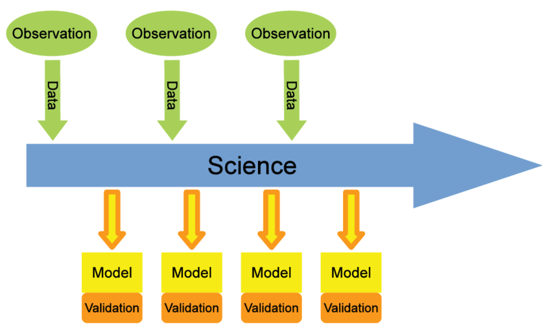
We need data to study the impact of spaceflight on health
https://www.researchgate.net/figure/A-scheme-of-the-process-of-scientific-research-The-main-input-is-data-from-observations_fig1_266946243
Notes:
In order to conduct space biology research, we need data. Data are gathered from observations in ground experiments as well as spaceflight experiments to model the impact of spaceflight on the health of an organism. These models need to be built, tested, and validated, and all that requires data. Unfortunately, experimental data in space is extremely limited. And data from astronauts is precious few and usually so sensitive that it cannot be shared broadly to the scientific community.

Slide 6

Often we use model organisms
https://genelab.nasa.gov/awg/join
Notes:
So in the absence of experimental data on humans, we turn to other organisms as models. One mammal which is relatively “close” to humans is the mouse, and most of the data we will be looking at in this course is gathered from experiments with mice. Other organisms, including fruit flies, worms, plants, and microbes are not evolutionarily close or physiologically similar to humans but are still informative in their own right as to the impact of spaceflight on living things.

Slide 7
Describe experiments for space biology research
Notes:
In this section, we describe how experiments are conducted in space biology research.

Slide 8
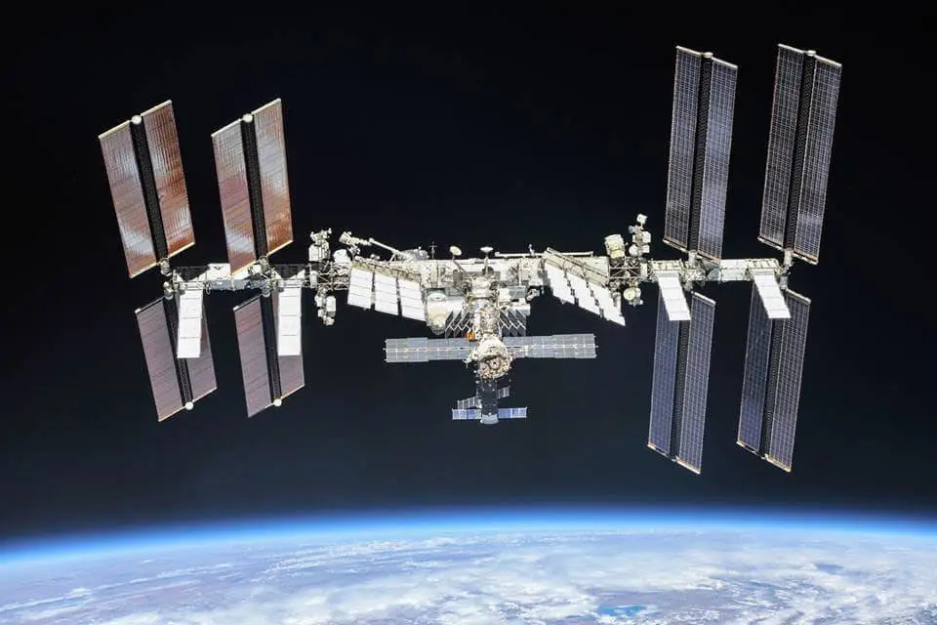
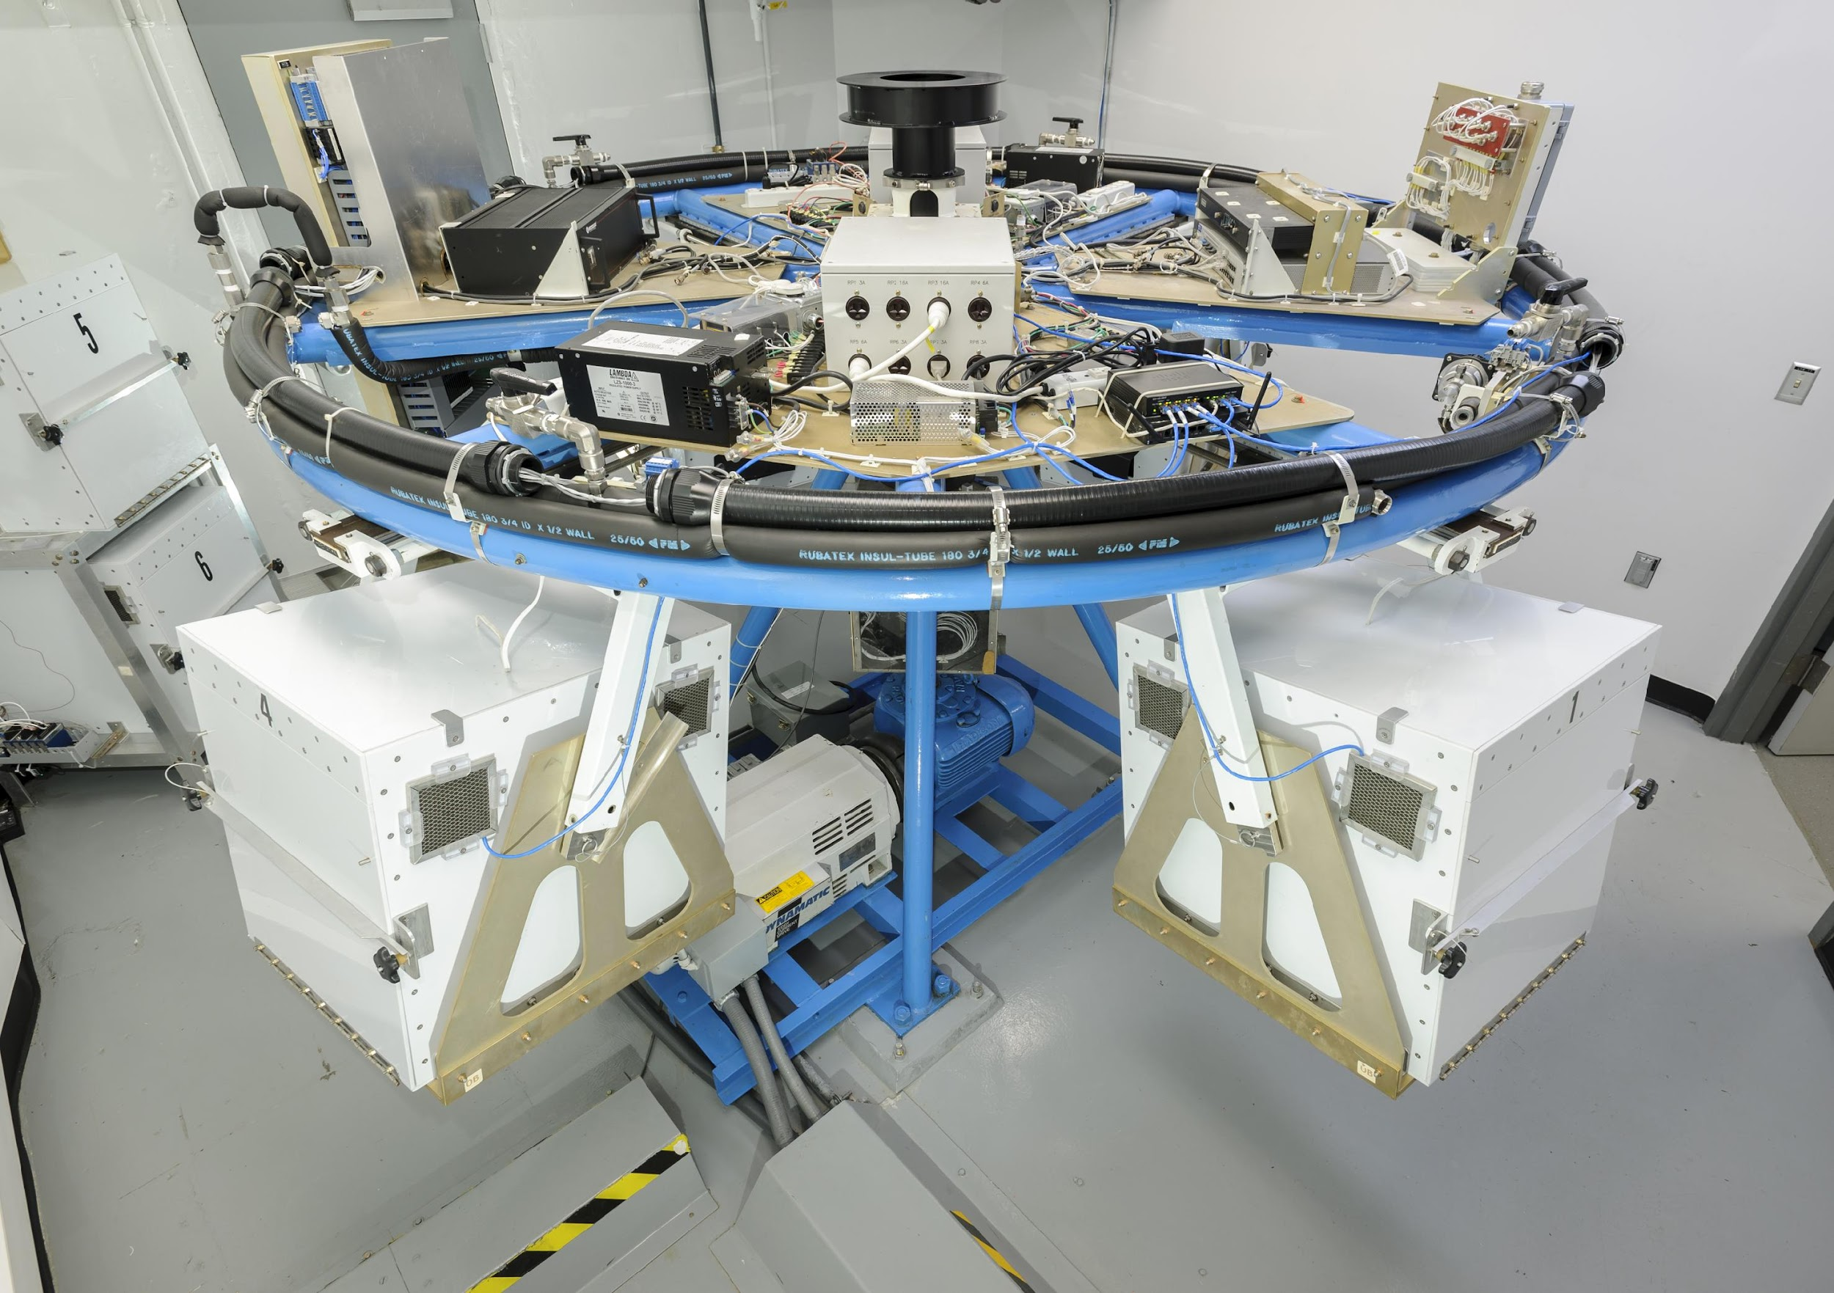
Where are space biology experiments performed?
In space – real microgravity
On Earth – simulating microgravity
https://www.nasa.gov/history/space-station-20th-historical-origins-of-iss/
https://www.nasa.gov/ames/space-biosciences/1-22-meter-radius-centrifuge/
Notes:
The best space biology experiments are conducted in space, but they are also the most expensive. The International Space Station has been in low-Earth orbit since 1998 and conducted thousands of space biology experiments using all those model organisms we discussed earlier. But each experiment only has a few samples because there’s such a high cost to transporting them, conducting the experiments, and returning those organisms back to Earth. To compensate for that, space biology researchers simulate the effects of spaceflight on Earth. One simulation they do is to simulate the effect of microgravity by spinning organisms in a centrifuge.

Slide 9

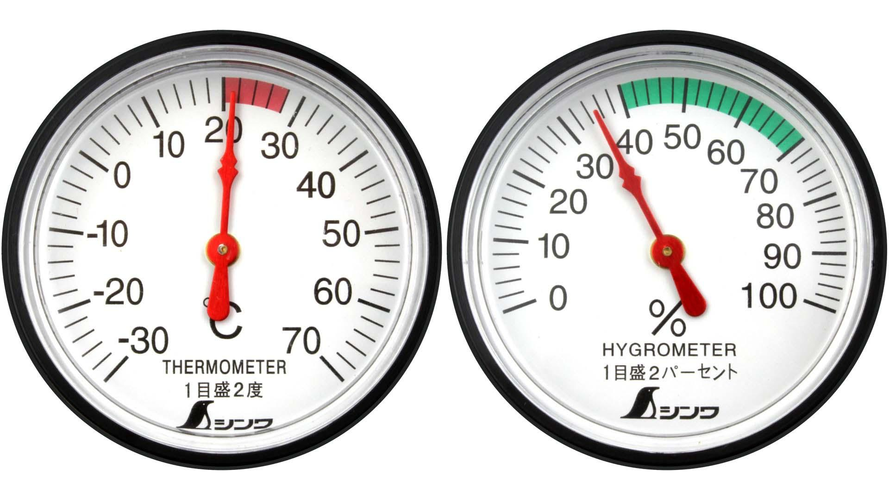
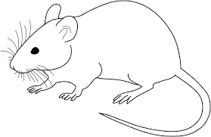
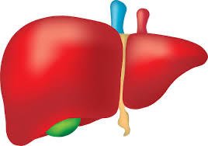
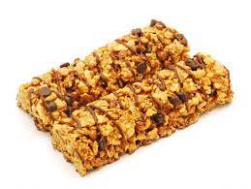


How are space biology experiments performed?
Notes:
Controlled space biology experiments are conducted with the experimental group in space and the control group here on Earth. Their conditions are matched identically, including temperature, pressure, humidity, food, water, light, size and type of cage, … etc so as to precisely isolate the effect of spaceflight on health.

Slide 10
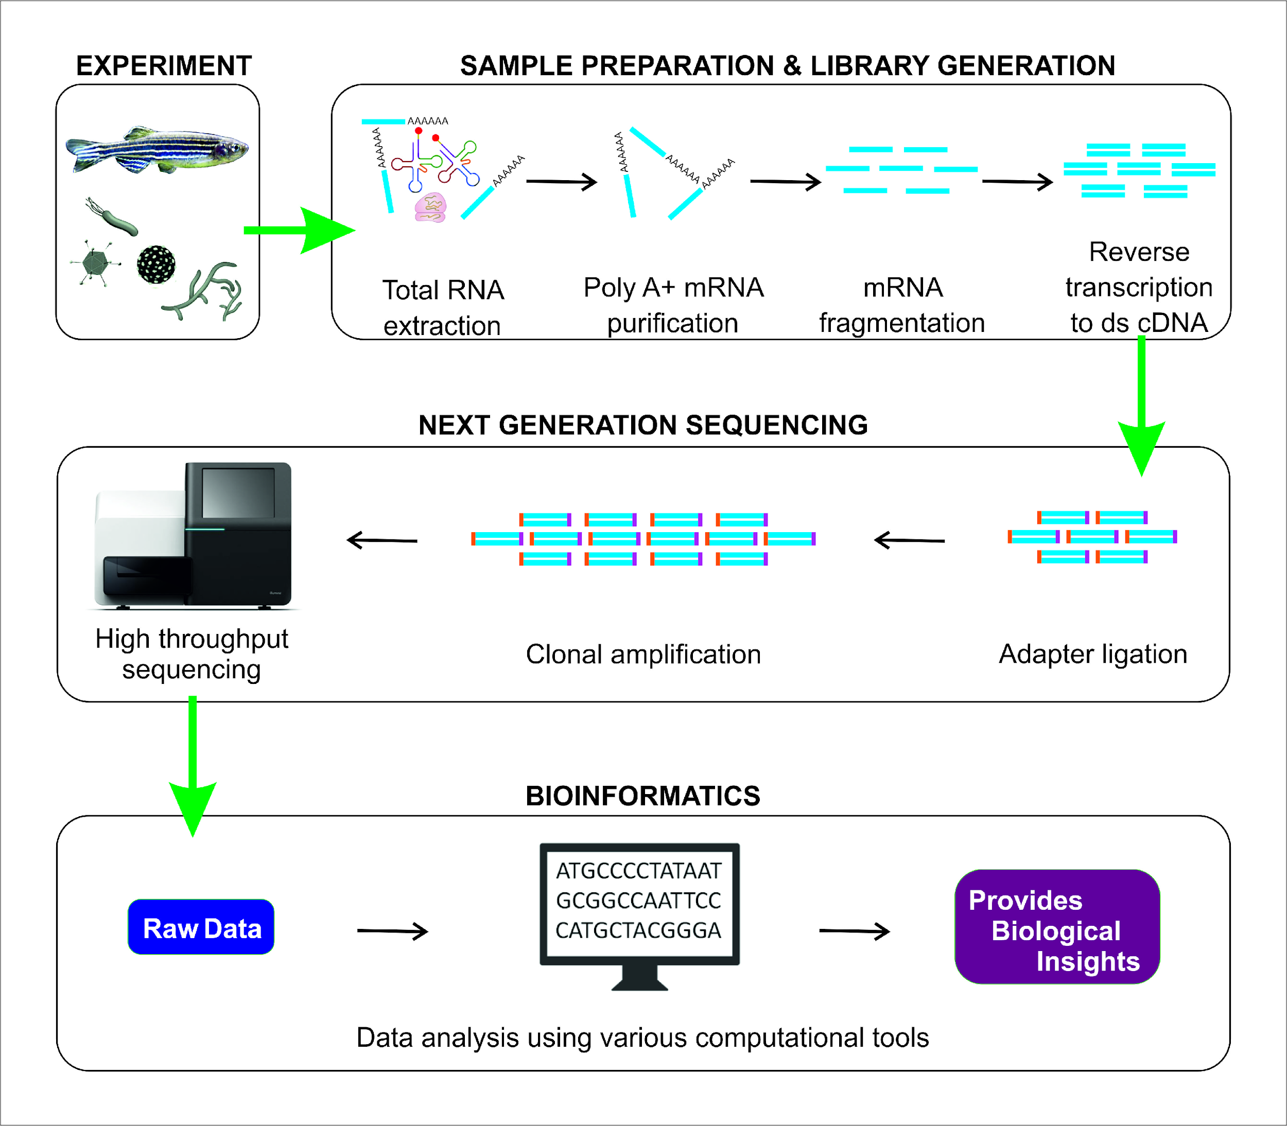
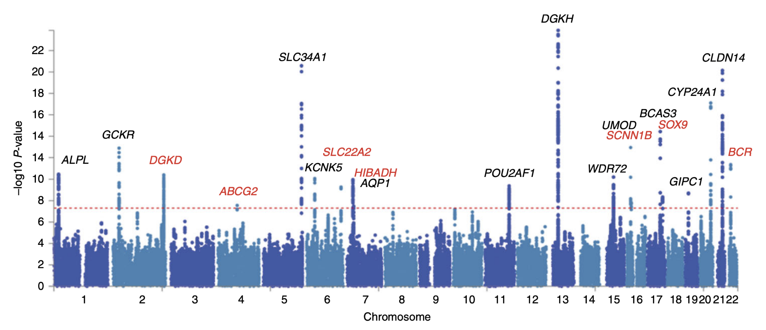
Molecular experiments
https://en.wikipedia.org/wiki/Genome-wide_association_study
https://www.mdpi.com/1422-0067/19/1/245
Notes:
Molecular experiments are conducted to determine genomic, transcriptomic, and proteomic -level differences between space flight and ground control samples.
A genome-wide association study is an observational study of a genome-wide set of genetic variants in different individuals to identify variants associated with a trait.
RNA sequencing is a technique that uses next-generation sequencing to identify and quantify RNA molecules in a biological sample, providing a snapshot of the genes being expressed in that tissue at that point in time.
Other molecular experiments (not shown in the slide) include mass spectrometry which uses ion beams to identify and quantify protein molecules in a biological sample, providing a snapshot of the proteins transcribed in that tissue at that point in time.

Slide 11
Molecular experiments: example (RNA-seq)
Wet lab
Dry lab
https://www.mdpi.com/1422-0067/19/1/245
Notes:
RNA sequencing has 2 primary components – a wet lab component where chemical reactions are used to extract, purify, amplify, and sequence RNA fragments; and a dry lab component where those RNA fragments are quantified and analyzed. This specific type of experiment tells us which genes are being differentially expressed between spaceflight and ground control experiments. These differences in gene expression then tell us which biological pathways are being turned on (or turned off) in response to the conditions of space.

Slide 12
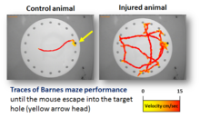
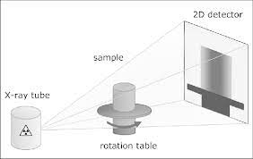
Phenotype experiments
maze performance
micro-computed tomography
https://en.wikipedia.org/wiki/Barnes_maze
https://journals.viamedica.pl/folia_morphologica/article/view/37360
Notes:
As opposed to molecular experiments which are used to quantify genomic, transcriptomic, and proteomic differences between experimental groups at the molecular level, phenotype experiments measure the response of the organism at a cellular, system, or even organism wide-level.
For example, behavioral experiments may measure the experimental effect on model organism behavior such as maze performance, gait characteristics, and climbing.
Micro-computed tomography is a non-destructive imaging technique which uses X-rays to provide high-resolution 3-dimensional images of bone structures.
Not shown in the slide, immunostaining methods use dyes, enzymes, or other reagents to detect the presence or absence of a particular protein, characterize it’s distribution across tissue, or analyze its sub-cellular localization.

Slide 13
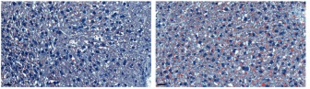
Phenotype experiments: example (oil red O staining)
https://www.mdpi.com/2075-1729/10/10/235
Notes:
Staining tissue samples and studying the stains under magnification can help scientists quantify the presence or absence of certain proteins in situ. Oil red O is one such staining technique that stains lipid molecules red. Looking carefully at the 2 images, it seems the one on the right has more red than the one on the left, suggesting there’s a higher lipid density in that tissue. However, images such as this need to be quantified (exactly what percentage of the slide is red?) in order to be used in research.

Slide 14
Define data types and formats for space biology experiments
Notes:
In this section, we define data types and formats for space biology experiments.

Slide 15
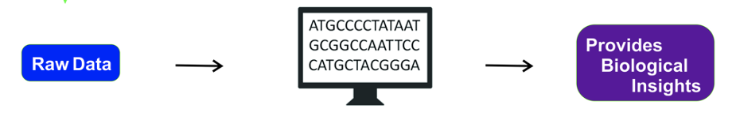
Dry lab: transform raw data into biological insights
Notes:
As a reminder from earlier in this presentation, in the dry lab, scientists transform raw data into biological insights. Those biological insights in space biology research characterize the impact of spaceflight on the health of an organism.

Slide 16
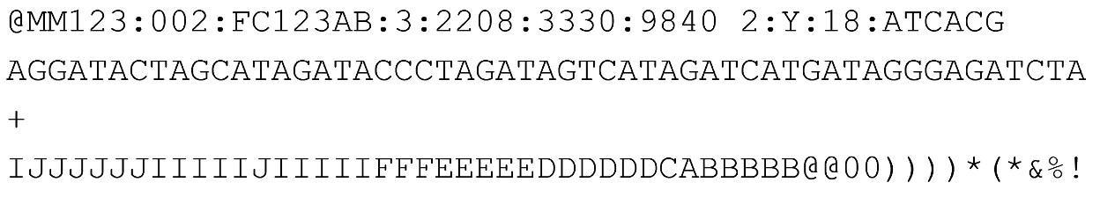
Molecular experiments: example (RNA-seq)
each letter represents a nucleotide from an RNA sequence reverse-transcribed into DNA
fastq file
(raw data)
each symbol represents a quality metric associated with the read
https://www.researchgate.net/figure/FASTQ-file-format-example_fig8_303293093
Notes:
In the case of RNA-seq molecular experiments, the RNA transcripts are sequenced nucleotide by nucleotide. In the example in this slide, the RNA sequence is reverse transcribed from RNA to DNA so scientists can map these sequences to the organism genome. In this way, we can quantify how much of each gene is being expressed in this organism’s tissue at this point in time, providing a snapshot of the response of the organism to its space environment. This is the raw data that scientists in the dry lab start with.

Slide 17
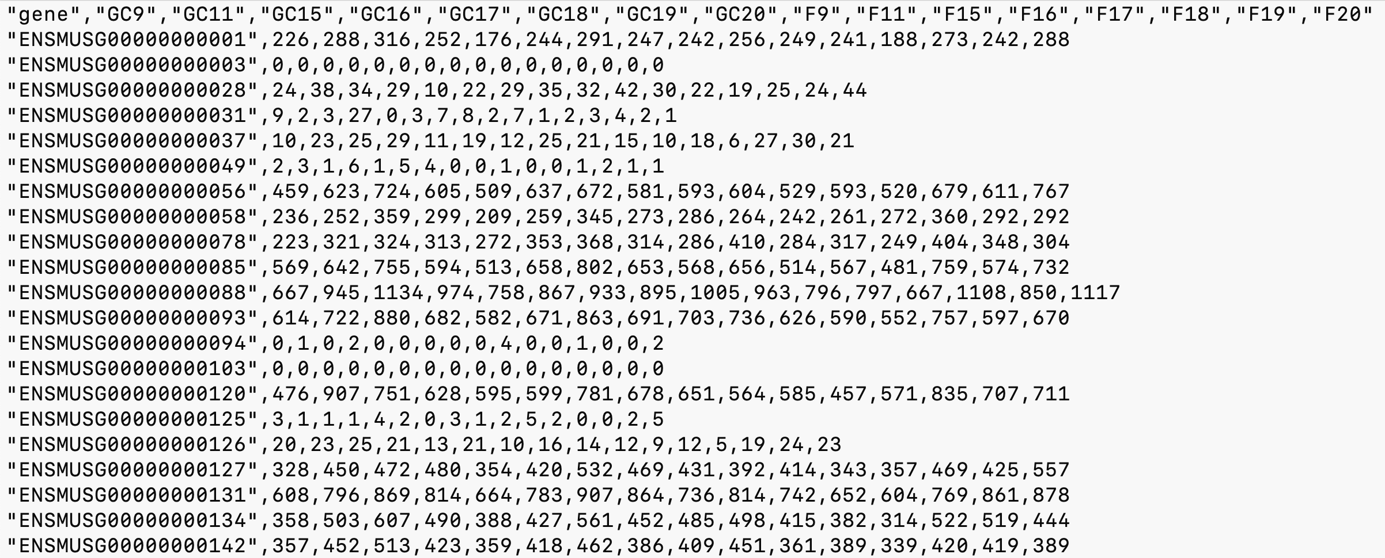
Molecular experiments: example (RNA-seq prepared data)
CSV file
(prepared data)
357 = number of RNA transcripts of gene ENSMUSG000000142 found for sample GC9
Notes:
After the RNA transcripts have been sequenced and mapped to a genome, scientists know which genes are under- and over-expressed between spaceflight and ground control samples. In this slide, ground control sample 9’s gene ENSMUSG142 has 357 transcripts. Scientists use these prepared data compare the ground control gene expression to spaceflight gene expression.

Slide 18
Phenotype experiments: example (ORO)
microscopy image
(raw data)
Notes:
Just as with RNA-seq which quantifies gene expression, phenotype experiments which involve staining/imaging techniques such as Oil Red O also quantify the presence of some molecule or protein. And just like RNA-seq needs to get mapped to a genome in order to get quantified, microscopy images need to be quantified somehow as well.

Slide 19
Phenotype experiments: example (ORO)
12.02
17.43
microscopy image
(processed data)
Notes:
In the case of Oil Red O, it gets quantified by using software programs that count the number of red pixels in the image and then representing that as a percentage of the entire image pixels. In this example, the slide on the left has 12.02% red pixels and the slide on the right has 17.43% red pixels, both indicating the amount of lipid proteins in that tissue at that point in time.

Slide 20
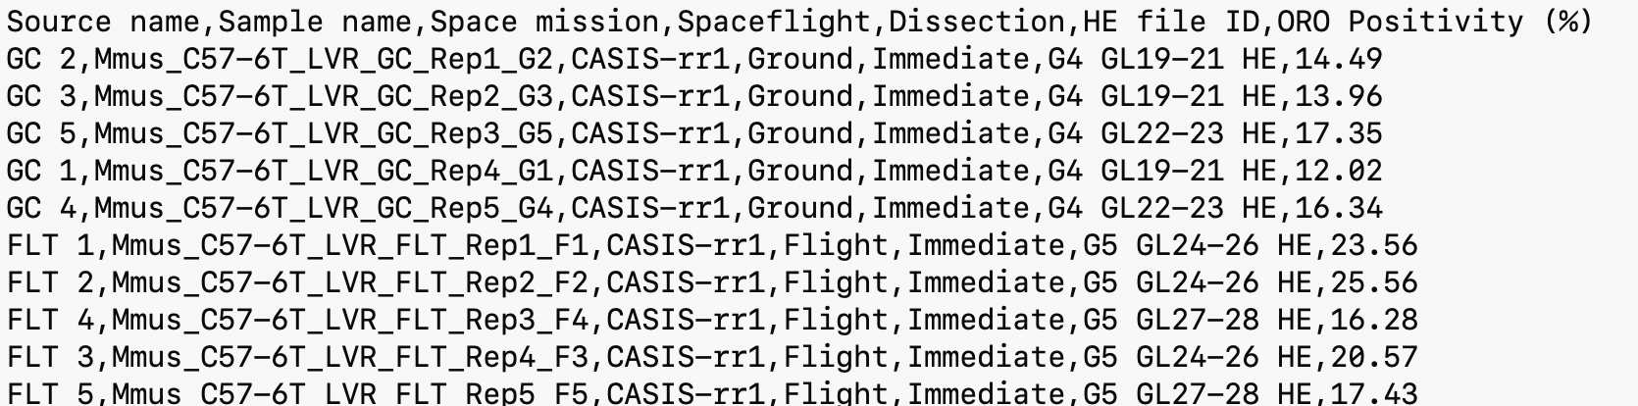
Phenotype experiments: example (ORO)
17.43 = percentage of liver cell image stained red for sample Mmus_C57-6T_LVR_FLT.
CSV file
(prepared data)
Notes:
Just like with RNA-seq, we can then put those values into a tabular file such as what is shown in this graphic. The last column of the table represents the Oil Red O percentage, which is 17.43% for the space flight sample 5.

Slide 21
Define data types and formats for machine learning models
Notes:
In this section, we define data types and formats for machine learning models.

Slide 22
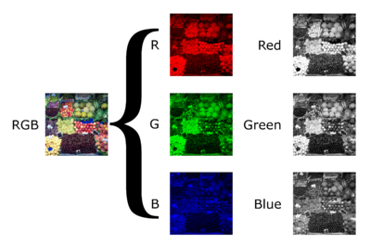
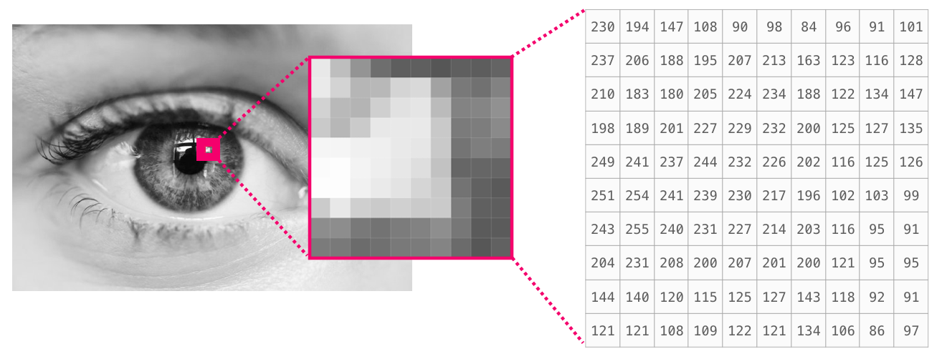



Image data
pixel = scalar gray-scale or RGB triplet
Image = 2-dimensional array of pixels
https://anopheles-genomic-surveillance.github.io/workshop-4/module-1-numpy.html
https://en.wikipedia.org/wiki/Grayscale
Notes:
2-dimensional image data can either be stored in gray-scale or in red-green-blue (RGB) scale. The image is represented as an array of pixels, each of which represents a color or grayscale for that pixel. Image processing tools such as OpenCV, Pillow, and Image J know how to interpret the files in order to analyze and manipulate the images they represent.

Slide 23
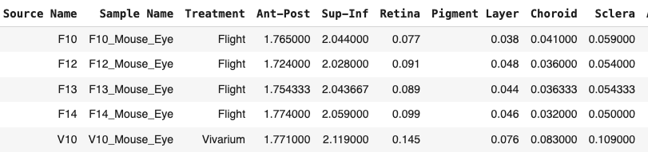


Tabular data
column
rows (5) x columns (9) = 45 cells
row
cell
Notes:
Tabular data, as opposed to imaging data, contains strings, integers, decimals, Boolean values, … etc and are arranged in an arbitrary order of columns and rows. A column in a table is a vertical cross-section and a row in a table represents a horizontal cross-section. Typically, rows represent samples (one row per sample) and columns represent observations (data and metadata) about that sample. A cell is the intersection of a row and a column. For example, in the table in this slide, sample F13’s Retina measurement is 0.089.

Slide 24
Numeric vs non-numeric
non-numeric value
numeric value
Notes:
Tables can contain both numeric-type data and non-numeric-type data. For example, the column named “Spaceflight” has values either “Ground” or “Flight”. Note that if there are only 2 possible values for a column, it can be represented in numeric form (e.g. 0 and 1). The ORO positivity % column has numeric values. These too could be converted to classes such as “low”, “medium”, and “high” or just “low” and “high”.

Slide 25


Integer vs float
integer data (raw counts of reads)
float data (normalized counts of reads)
Notes:
Numeric values can be further subdivided as integers (whole numbers) and floating point numbers (or floats). In this example, the counts for the gene “ENSMUSG1” are obviously integers, but the values can be normalized across the table to account for discrepancies such as batch effects and different sequencing depths. We’ll cover normalization in more detail in a later lesson.

Slide 26
Identify significantly different data distributions
Notes:
In this last section, we identify significantly different data distributions.

Slide 27
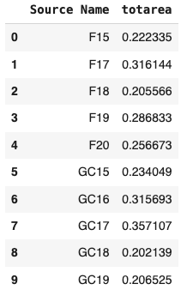
Comparing the means of 2 sets of data
How similar is the mean of the flight (F) samples to the mean of the ground control (GC) samples?
mean_flight = 0.252
mean_ground = 0.258
It’s hard to tell by just looking at the numbers.
Notes:
One way space biologists can determine if there is a difference in response to ground control and space flight is to examine the means of the observations. If those means are “very far apart”, then we can argue that there is a significant difference in response. But statistically speaking, we’ll need to be more rigorous than just waving our hands. In this slide example, the flight samples F15-F20 have a mean value of total area of 0.252 whereas the ground samples GC15-GC19 have a mean total area of 0.258. How significant is this difference? It’s hard to tell just by looking at the numbers.

Slide 28
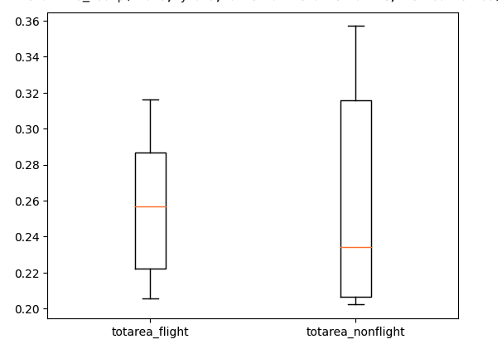
Comparing the means of 2 sets of data
It’s easier to compare the 2 sets (distributions) of data graphically, but not always.
The means don’t look very far apart, but the scale of the y-axis is too small to really know.
Notes:
It’s easier to compare the distributions of the data graphically, but not always. Boxplots are simple ways to graphically show a distribution of data. The orange line in the box represents the arithmetic mean, the top of the box is the 75th percentile, and the bottom of the box is the 25th percentile. The 2 box plots look similar, but the scale of the y-axis is too small to really know.

Slide 29
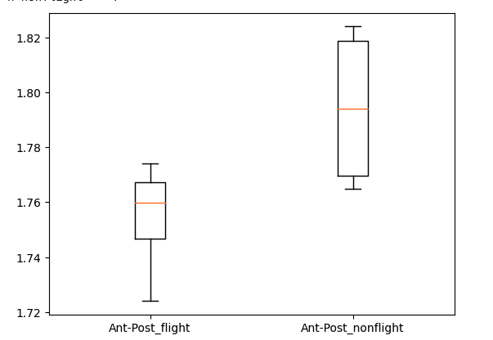
Comparing the means of 2 sets of data
These means look far apart, but if only there were a number that represents how different they are …
Notes:
In this example, the means (orange lines) look relatively far apart which would imply that the means are significantly different between the two groups. However, just using our eyes is not a very scientifically rigorous way to quantify that difference.

Slide 30
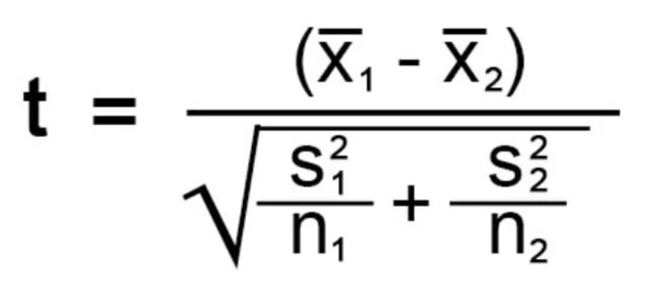
Comparing the means of 2 sets of data: t-test
This is called the Student t statistic. After calculating this t value, look the t value up in a table to get the p-value, and if that p-value is less than 0.05, the 2 means are statistically significantly different.
Notes:
There is a method in statistics called the student t-test which calculates a statistical value shown in the slide. x1-bar is the mean of the first distribution and x2-bar is the mean of the second distribution. s1 and s2 are the variances of the first and second distributions, respectively. And n1 and n2 are the sizes of those distributions. Plugging those values into this formula gives a float value for t. We then look this value of t up in a table to get the associated p-value. If that p-value is less than 0.05, then those means are considered to be statistically significantly different.

Slide 31
Comparing the means of 2 sets of data: t-test
or just run these 2 lines of code in Python:
from scipy import stats
stats.ttest_ind(flight_sample_values, ground_sample_values).pvalue
0.88406
⇒ because 0.88406 is higher than our threshold of 0.05, we conclude that the means of these 2 sets of data are not statistically significantly different.
Notes:
Of course, as programmers, we don’t want to do any calculations by hand but would rather automate everything. Instead, for this particular statistic called the t-test, we can provide the list of values for the flight samples and the list of values for the ground control samples to a function called ttest_ind(), and then examine the p-value associated with that statistic. P-values range from 0 to 1, and the closer to 0 means the more significant. If the p-value is less than 0.05, the means are significantly different. In the example in this slide, the p-value is 0.88406, so the means are not statistically significantly different.

